Slide 1
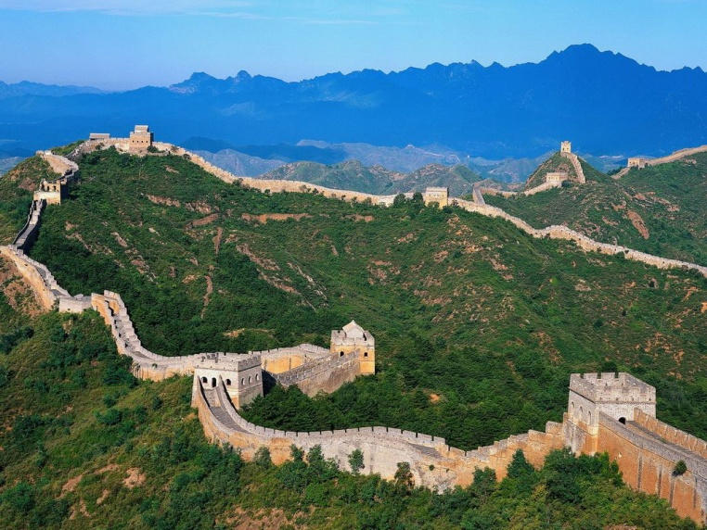
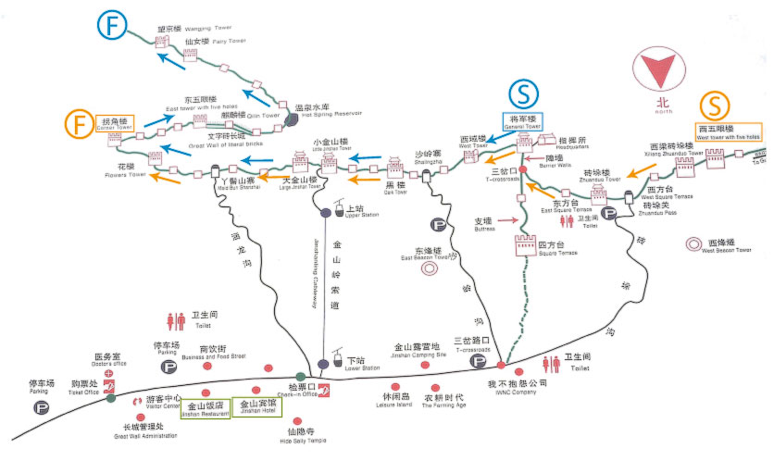
GREAT WALL OF CHINA CHARITY TREK MARCH 2013
Lyndsey Ryan and Alexandra Gilbertson plan a 5 day challenge of a lifetime trekking up to 9 hours a day through mountains and valleys raising funds for Manx brain tumour sufferers.
http://www.naseemsmanxbraintumourcharity.co.uk/

